Slide 1
Principles of Management
Chapter-16
Managing Employee Motivation and Performance

Slide 2
What is Motivation?
The set of forces that cause people to behave in certain ways.
Internal and external factors that stimulate desire and energy in people to be continually interested and committed to a job, role or subject, or to make an effort to attain a goal.

Slide 3

Determinants of Individual Performance
Motivation—the desire to do the job.
Ability—the capability to do the job.
Work environment—the resources
to do the job.

Slide 4
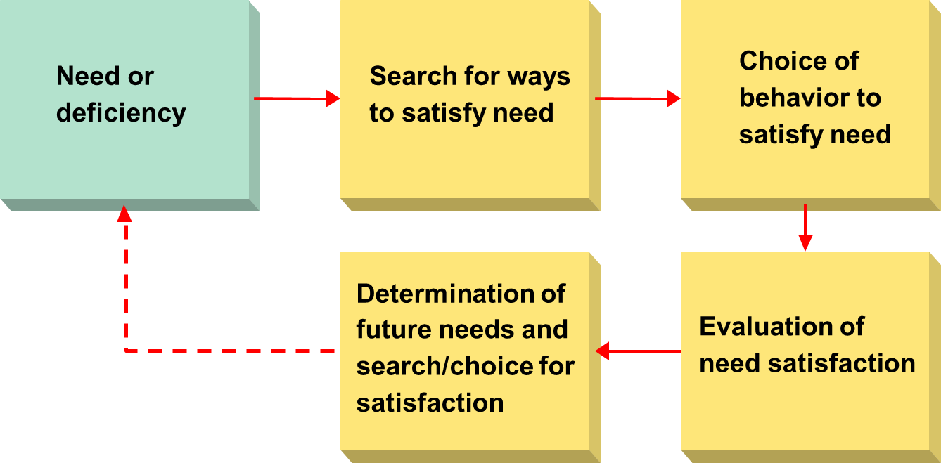
The Motivation Framework

Slide 5
Content Perspectives on Motivation
Content Perspectives
  Approaches to motivation that try to answer the question, “What factors in the workplace motivate people?”
Content Perspectives of Motivation
  Maslow’s Hierarchy of Needs Theory
  Aldefer’s ERG Theory
  Herzberg’s Two-Factor Theory
  McClelland’s Achievement,
  Power, and Affiliation Needs

Slide 6
Maslow’s Hierarchy of Needs Theory
    People must, in a hierarchical order, satisfy five groups of needs:
      Physiological needs for basic survival and biological function.
      Security needs for a safe physical and emotional environment.
      Belongingness needs for love and affection.
      Esteem needs for positive self-image/self-respect and recognition and respect from others.
      Self-actualization needs for realizing one’s potential for personal growth and development.

Slide 7
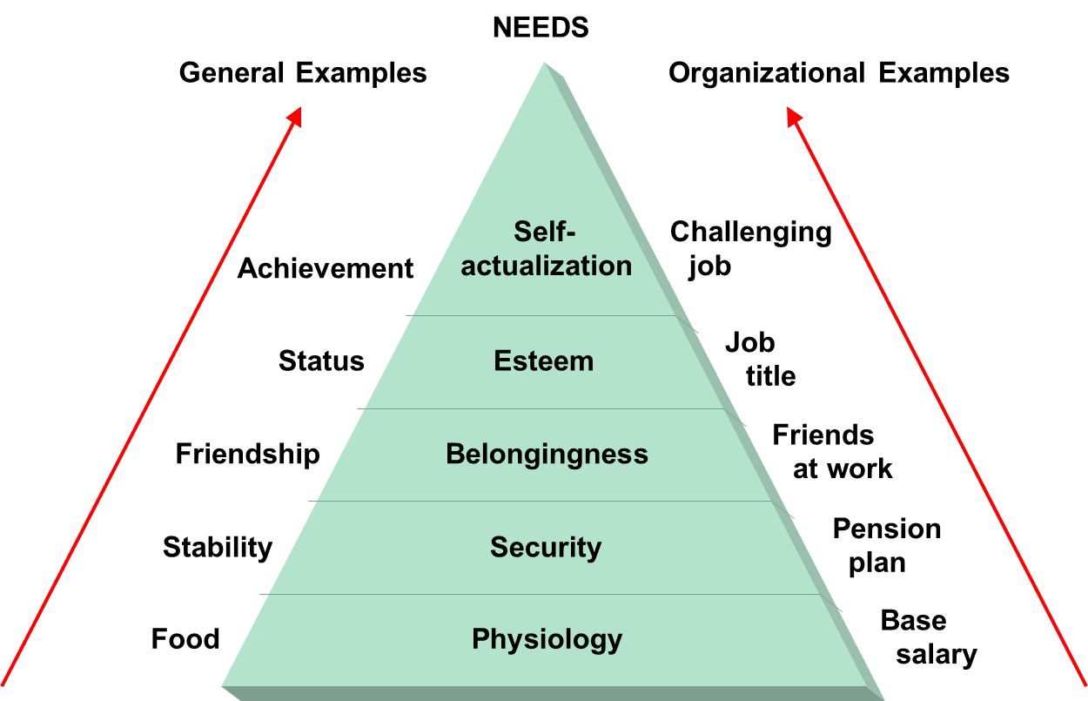
Maslow’s Hierarchy of Needs Theory

Slide 8
Maslow’s Hierarchy of Needs
  Weakness of Maslow’s theory
    Five levels of need are not always present.
    Ordering or importance of needs is not always the same.
    Cultural differences.
    Every individual is different from is other
    Not all employees are governed by same set of needs
    Each one driven by different needs at same point of time.

Slide 9
The Two-Factor Theory (Herzberg)
  People’s satisfaction and dissatisfaction are influenced by two independent sets of factors—motivation factors and hygiene factors.
    Motivational factors (work content) are on a continuum that ranges from satisfaction to no satisfaction.
    Hygiene factors (work environment) are on a separate continuum that ranges from dissatisfaction to no dissatisfaction.
    Motivation is a two-step process:
      Ensuring that the hygiene factors are not deficient and not blocking motivation.
      Giving employees the opportunity to experience motivational factors through job enrichment.

Slide 10
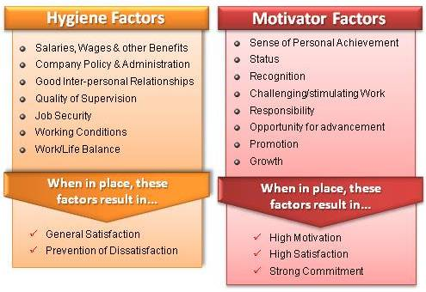
The Two-Factor Theory (Herzberg)

Slide 11
Process Perspectives on Motivation
Process Perspectives
  Approaches to motivation that focus on why people choose certain behavioral options to satisfy their needs and how they evaluate their satisfaction after they have attained their goals.
Process Perspectives of Motivation
  Expectancy Theory
  Porter-Lawler Extension of Expectancy Theory
  Equity Theory
  Goal-Setting Theory

Slide 12
Expectancy Theory
  Motivation depends on how much we want something and how likely we are to get it.
  Assumes that:
    Behavior is determined by a combination of personal and environmental forces.
    People make decisions about their own behavior in organizations.
    Different people have different types of needs, desires, and goals.
    People choose among alternatives of behaviors in selecting one that leads to a desired outcome.
    Motivation leads to effort, when combined with ability and environmental factors, that results in performance which, in turn, leads to various outcomes that have value (valence) to employees.

Slide 13
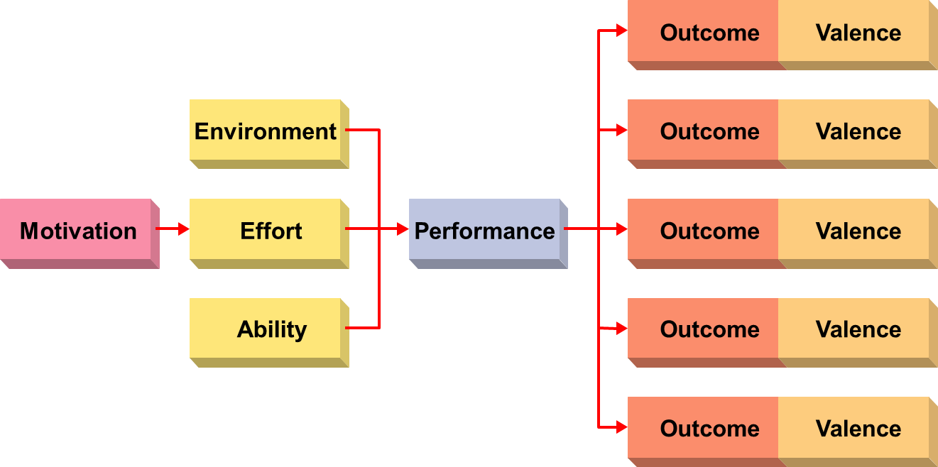
The Expectancy Model of Motivation

Slide 14
Porter-Lawler Extension of Expectancy Theory
  Assumptions:
    If performance in an organization results in equitable and fair rewards, people will be more satisfied.
    High performance can lead to rewards and high satisfaction.
  Types of rewards:
    Extrinsic rewards are outcomes set and awarded by external parties (e.g., pay and promotions).
    Intrinsic rewards are outcomes that are internal to the individual (e.g., self-esteem and feelings of accomplishment).

Slide 15
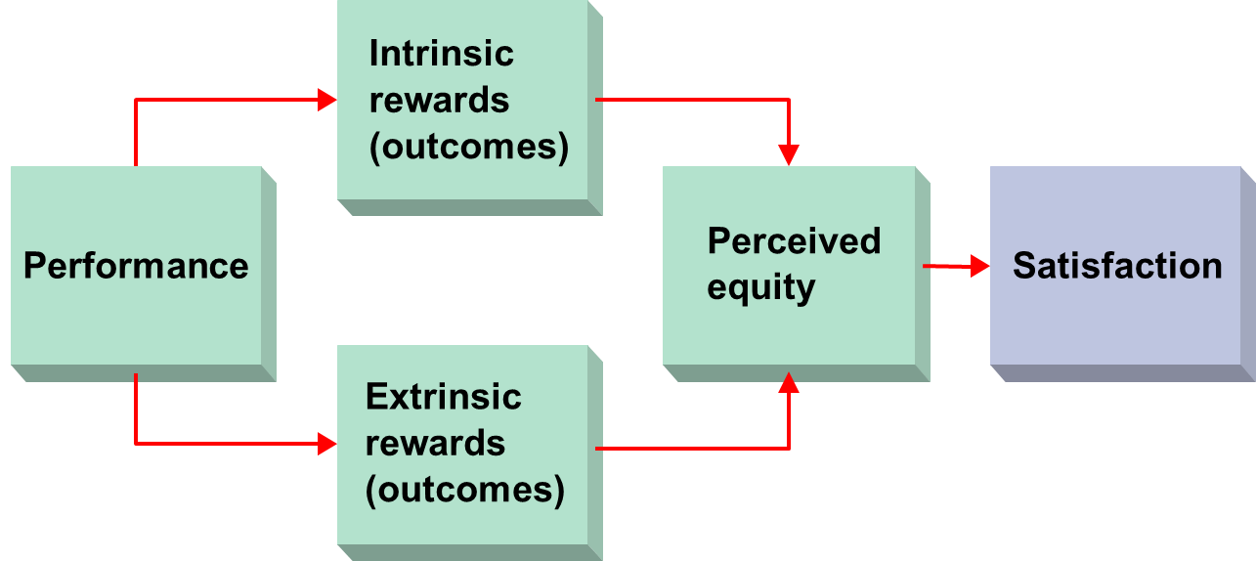
Porter-Lawler Extension of Expectancy Theory

Slide 16
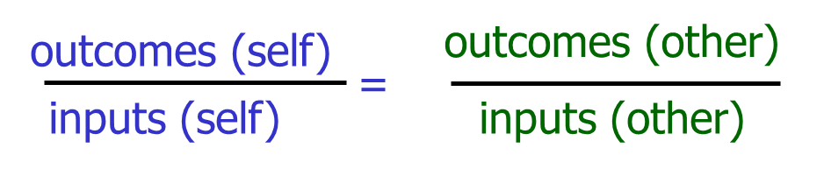
Equity Theory
  People are motivated to seek social equity in the rewards they receive for performance.
  Equity is an individual’s belief that the treatment he or she receives is fair relative to the treatment received by others.
  Individuals view the value of rewards (outcomes) and inputs of effort as ratios and make subjective comparisons of themselves to other people.

Slide 17
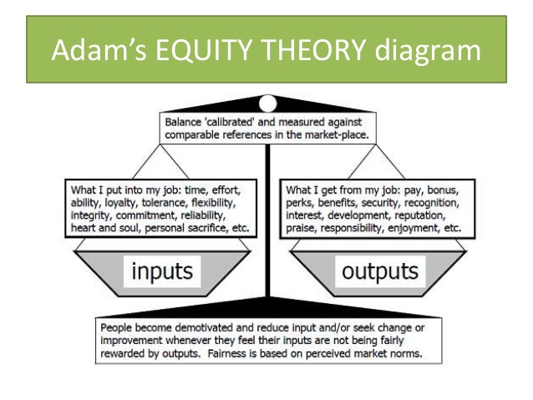

Slide 18
Goal-Setting Theory
  Assumptions
    Behavior is a result of conscious goals and intentions.
    Setting goals influence the behavior of people in organizations.
Characteristics of Goals (4)
  Goal difficulty
    Extent to which a goal is challenging and requires effort.
    People work harder to achieve more difficult goals.
    Goals should be difficult but attainable.

Slide 19
Goal-Setting Theory
  Goal specificity
    Clarity and precision of the goal.
    Goals vary in their ability to be stated specifically.
  Acceptance
    The extent to which persons accept a goal
    as their own.
  Commitment
    The extent to which an individual is
    personally interested in reaching a goal.

Slide 20
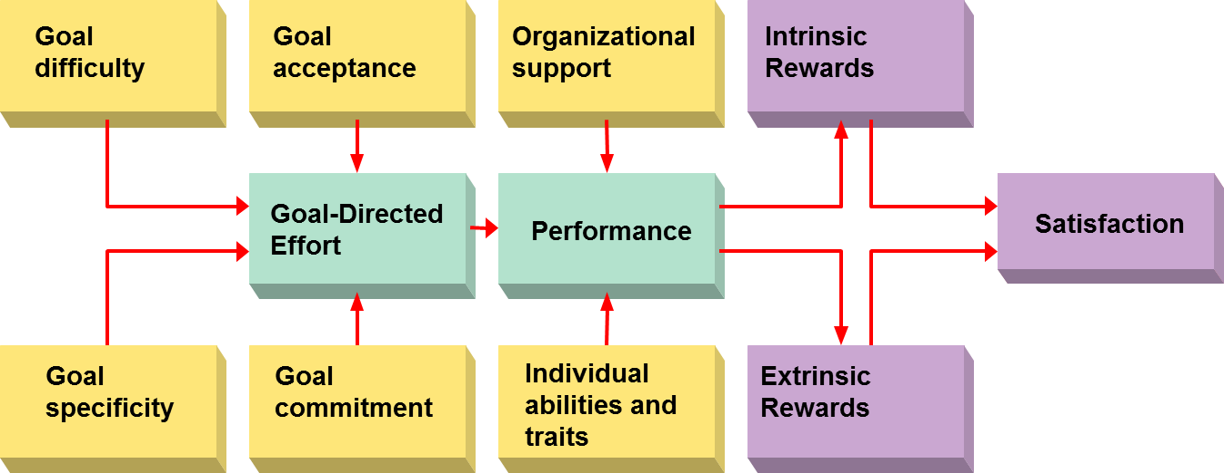
The Expanded Goal-Setting Theory of Motivation

Slide 21
Reinforcement Perspectives on Motivation
Reinforcement Theory
  The role of rewards as they cause behavior to change or remain the same over time.
  Assumes that:
    Behavior that results in rewarding consequences is likely to be repeated, whereas behavior that results in punishing consequences is less likely to be repeated.

Slide 22
Reinforcement Perspectives on Motivation
  Positive reinforcement
    Strengthens behavior with rewards or positive outcomes after a desired behavior is performed.
  Avoidance
    Strengthens behavior by avoiding unpleasant consequences that would result if the behavior is not performed.
  Punishment
    Weakens undesired behavior by using negative outcomes or unpleasant consequences when the behavior is performed.
  Extinction
    Weakens undesired behavior by simply ignoring or not reinforcing that behavior.

Slide 23
Popular Motivational Strategies
Empowerment and Participation
  Empowerment
    The process of enabling workers to set their own work goals, make decisions, and solve problems within their sphere of influence.
  Participation
    The process of giving employees a voice in making decisions about their work.

Slide 24
Popular Motivational Strategies
New Forms of Working Arrangements
  Variable Work Schedules
    Compressed work schedule—Working a full forty-hour week in less than five days.
    Flexible work schedules (flextime)—Allowing employees to select, within broad parameters, the hours they will work.
    Job sharing—When two part-time employees share one full-time job.
    Telecommuting—Allowing employees to spend
    part of their time working off-site, usually
    at home, by using e-mail, the Internet, and
    other forms of information technology.

Slide 25
Using Reward Systems to Motivate Performance
Reward System
  The formal and informal mechanisms by which employee performance is defined, evaluated, and rewarded.
Effects of Organizational Rewards
  Effect of Rewards on Attitudes
  Effect of Rewards on Behaviors
  Effect of Rewards on Motivation

Slide 26
Using Reward Systems to Motivate Performance
Designing Effective Reward
  Reward system must meet an individual’s needs.
  Rewards should compare favorably with other organizations.
  Distribution of rewards must be perceived to be equitable.
  Reward system must recognize different needs.

